Slide 1
Higher
Order
Observables

Slide 2
Agenda
Implementation pattern
Marble diagrams
Operators
Higher order mojo

Slide 3






Angular by heart and code
Development, Workshops, Community

Slide 4

Who explored Rx?

Slide 5
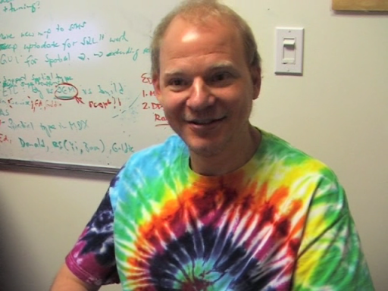
Eric Meijer
Channel9

Slide 6
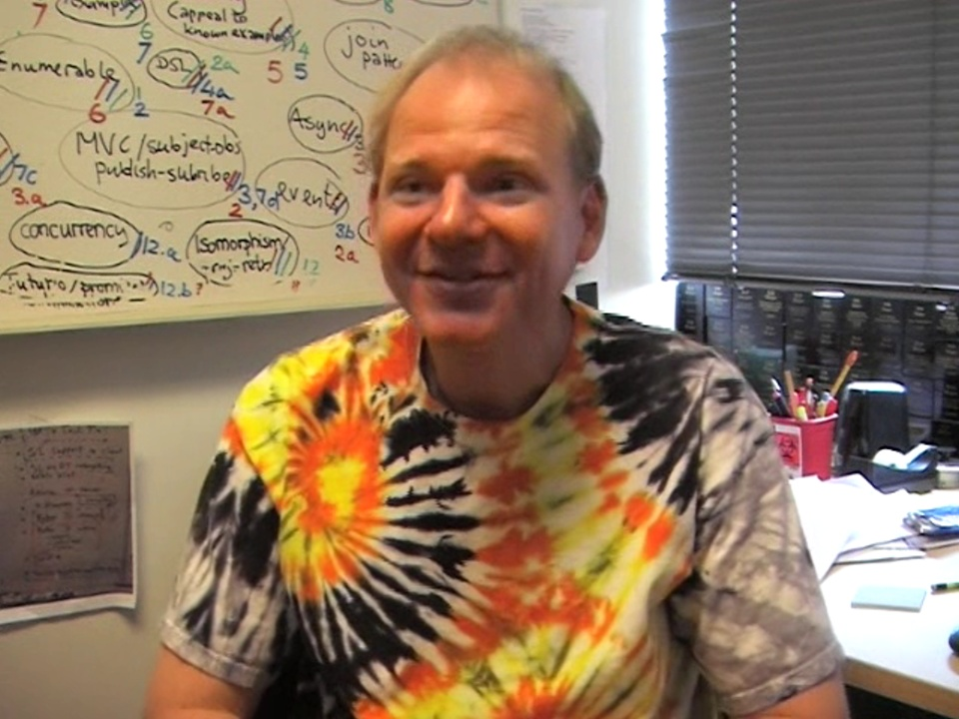
Special Skills
Awesome teacher
Sharp minded
Colorful t-shirts
Funny hobbies
Channel9

Slide 7

Recipe for a great idea?

Slide 8

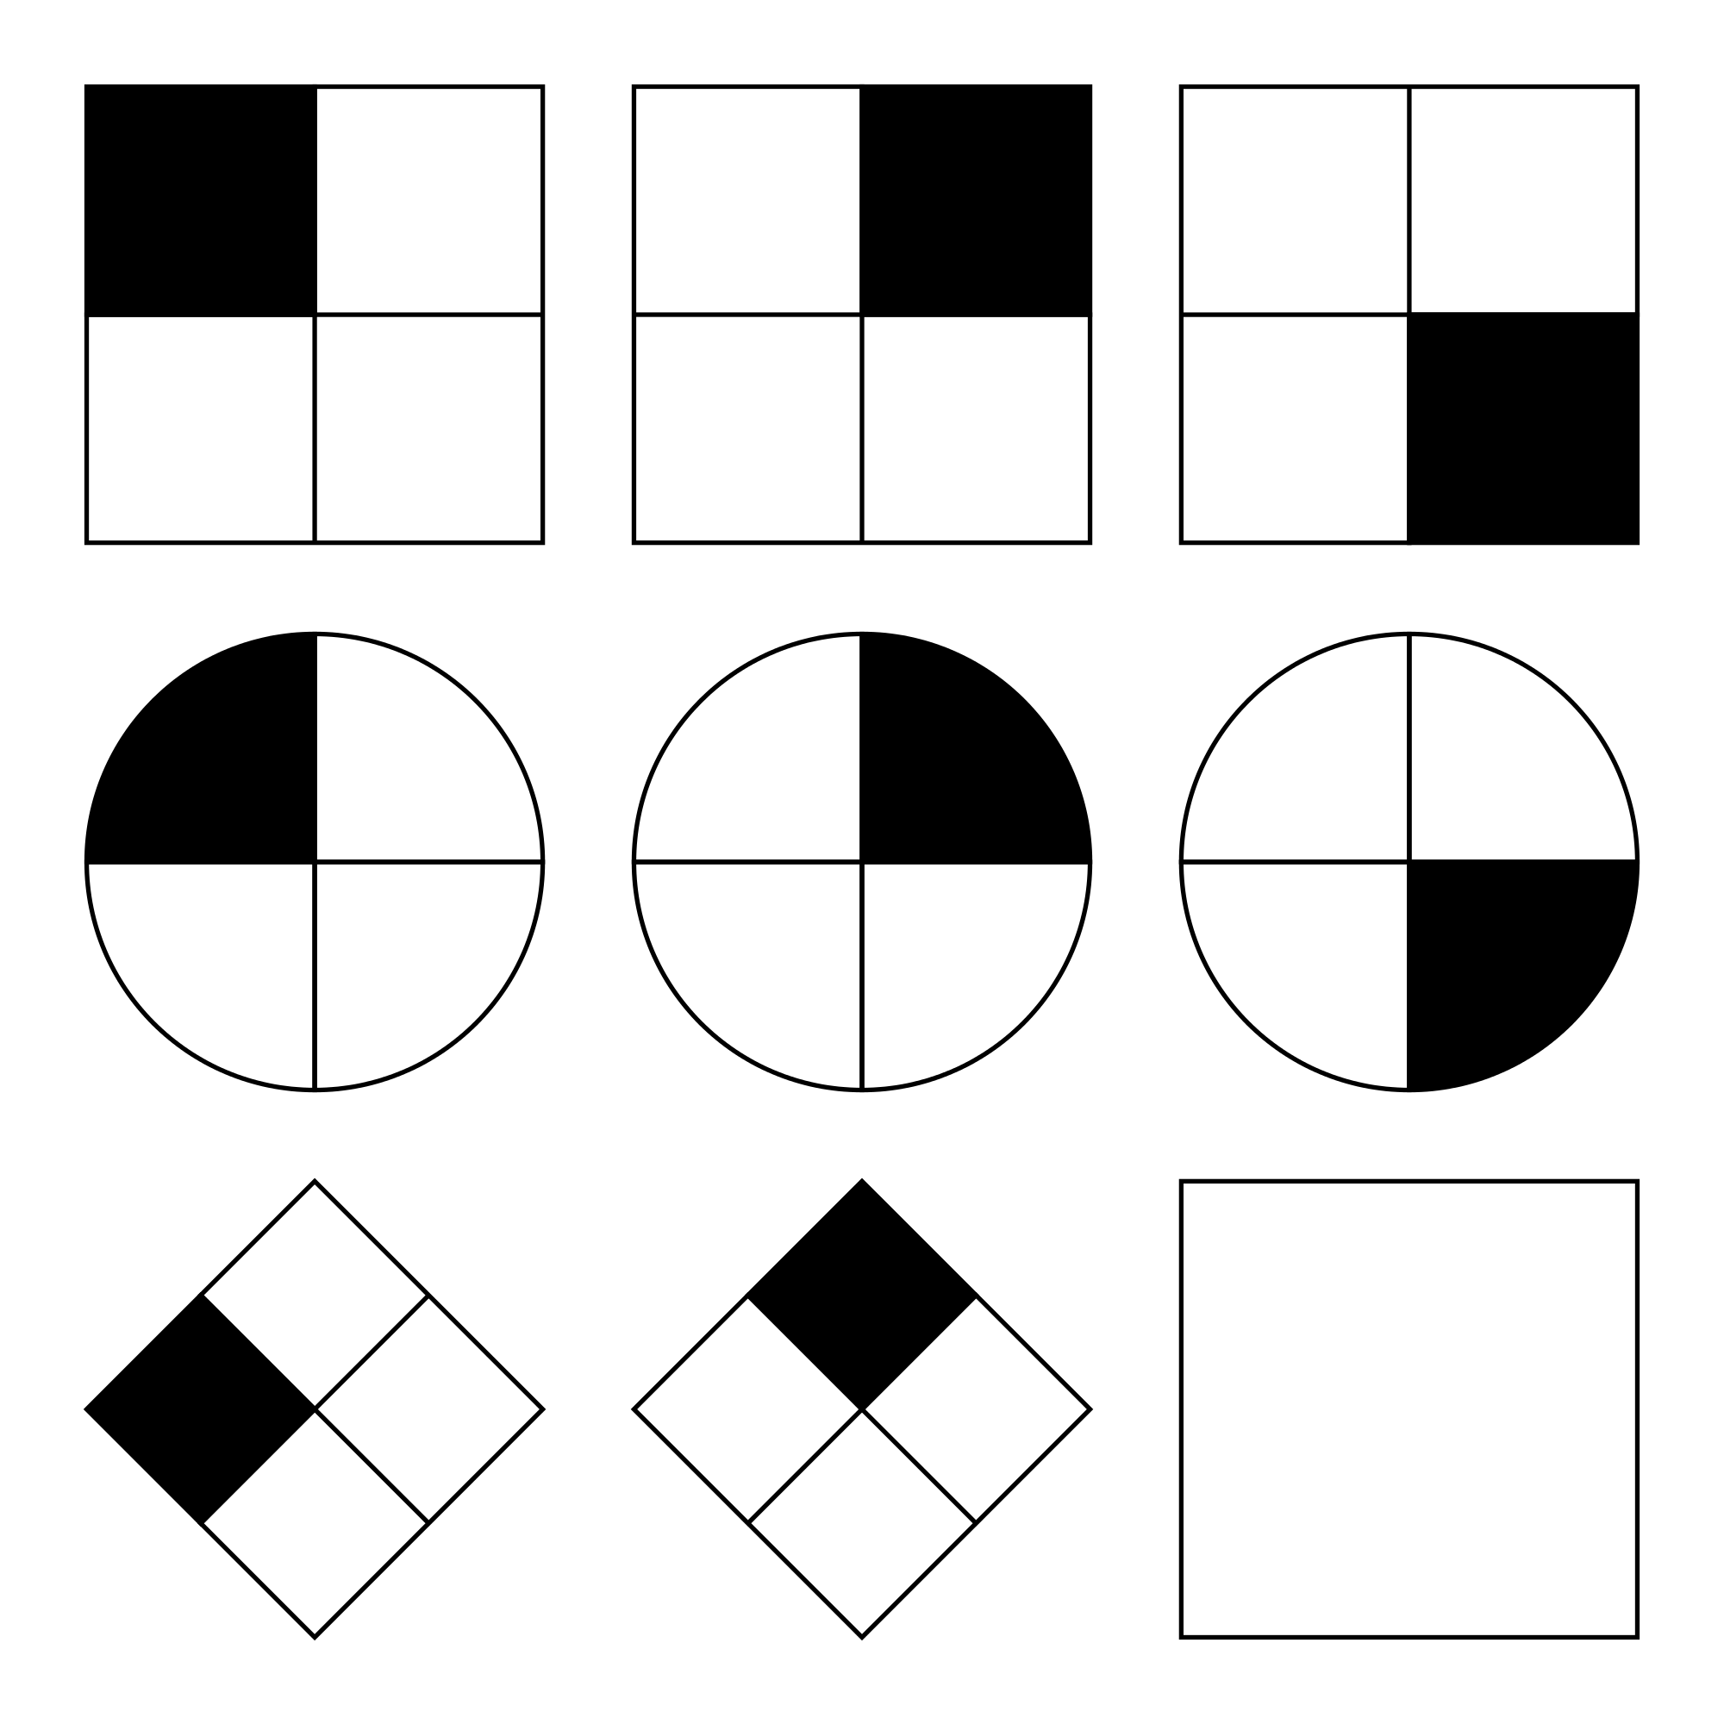
Recipe for a great idea!
CODE
&
Raven Tests
Programming Manuals

Slide 9

Reactive Extensions

Slide 10

The missing link in collections

Slide 11
Collections
Pull based
Push based

Slide 12
Collections
Pull based
Push based
Standard operators

Slide 13
Collections
Pull based
Push based
Standard operators
Extras

Slide 14
Collections
Pull based
Push based
Standard operators
Extras

Slide 15
Collections
Pull based
Push based
Standard operators
Standard operators
Extras

Slide 16
Collections
Pull based
Push based
Standard operators
Standard operators
Extras
Extras

Slide 17

The trick with infinite collections

Slide 18
Array
map
filter
const numbers = [1,2,3,4,5];
numbers
.map(n => n * 2)
.filter(n => n > 7)
// [8, 10]
console.log(numbers);
1
2
2
2
4
4
3
6
6
4
8
8
5
10
10

Slide 19
Observable
map
filter
1
2
2
const numbers$ = Observable.of(1,2,3,4,5);
numbers$
.map(n => n * 2)
.filter(n => n > 7)
// 8, 10
.subscribe(console.log);
2
4
4
3
6
6
4
8
8
5
10
10

Slide 20
Supported languages
Java: RxJava
JavaScript: RxJS
C#: Rx.NET
C#(Unity): UniRx
Scala: RxScala
Clojure: RxClojure
JRuby: RxJRuby
Kotlin: RxKotlin
Swift: RxSwift
PHP: RxPHP
Elixir: reaxive
Dart: RxDart
C++: RxCpp
Lua: RxLua
Ruby: Rx.rb
Python: RxPY
Go: RxGo
Groovy: RxGroovy

Slide 21
Marble Diagrams
source$
operator( => )
result$

Slide 22
BUILDING BLOCKS
7
8
9
11
10
12
42ms
opr
opr
Time Progress
Value
Values Grouped
Operator
Connect
Operator Context
1
2
3
4
5
6
Time
Complete
Error
Transform
Subscribe
Unsubscribe

Slide 23
Time
Time progresses from left to right
It’s the one of the main parts in marble diagrams

Slide 24
Time
Time progresses from left to right
It’s the one of the main parts in marble diagrams
To declare specific time in diagrams we can use numbers
42ms

Slide 25
Values
The values in time are the marbles

Slide 26
Values
The values in time are the marbles
To differ values we can use different shapes
Also different colors are possible
To be more specific we can fill shapes with content
1
a
{ }

Slide 27
Completion
If a stream ends we call it complete
After completion it is ”dead” and not working any more

Slide 28
Error
In stream errors can occur
After an error it is ”dead” and not working any more

Slide 29
Operators
Operators transform the values in streams

Slide 30
Operators
Operators transform the values in streams
They can be described with text
map

Slide 31
Operators
Operators transform the values in streams
They can be described with text
Text and psudo code
map(v => v * 2)

Slide 32
Operators
Operators transform the values in streams
They can be described with text
Text and psudo code
Or also in combination with marbles
mergeMap( => )

Slide 33
Subscription
As observables are lazy we need to call them to start
mergeMap( => )

Slide 34
Subscription
As observables are lazy we need to call them to start
Later on we can unsubscribe to stop receiving values
mergeMap( => )

Slide 35
Operators overview
We can group operators in following groups:
- Creation Operators

Slide 36
Of
of( 1, 2, 3 )
numbers$
1
2
3

Slide 37
Operators overview
We can group operators in following groups:
- Creation Operators
- Transformation Operators

Slide 38
Map
keyDown$
map( => )
timestamps$

Slide 39
Operators overview
We can group operators in following groups:
- Creation Operators
- Transformation Operators
- Filtering Operators

Slide 40
Filter
numbers$
1
3
2
filter( v => v < 3 )
numbers2$
1
3
2

Slide 41
Operators overview
We can group operators in following groups:
- Creation Operators
- Transformation Operators
- Filtering Operators
- Combination Operators

Slide 42
Merge (create operator)
btnClick$
keyDown$
merge( [] => )
btnClickAndKeyDown$

Slide 43
Operators overview
We can group operators in following groups:
- Creation Operators
- Transformation Operators
- Filtering Operators
- Combination Operators
- Multicasting Operators

Slide 44
Share
numbers$
share()
numbers1$
numbers2$

Slide 45
Operators overview
We can group operators in following groups:
- Creation Operators
- Transformation Operators
- Filtering Operators
- Combination Operators
- Multicasting Operators
- Error Handling Operators

Slide 46
CatchError
numbers1$
1
catchError(e => ‘?’)
result$
1
?

Slide 47
Higher Order Observables And Operators

Slide 48
Observable Order
First-Order Observable
1
2
Second-Order Observable
Third-Order Observable

Slide 49
Higher Order Observable
First-Order Observable
1
2
Higher-Order Observable

Slide 50
Operator Order
First-Order Operator
firstOrder( => )
Second-Order Operator
secondOrder( => )
Second-Order Operator
secondOrder( => )
Second-Order Operator
secondOrder( => )
Third-Order Operator
thirdOrder( => )

Slide 51
Higher Order Operator
First-Order Operator
firstOrder( => )
Higher-Order Operator
higherOrder( => )

Slide 52
mergeMap
switchMap
concatMap
exhaustMap
VS

Slide 53
mergeMap
switchMap
concatMap
exhaustMap

Slide 54
map

Slide 55
map
input$
1
2
3
4
map(v => v * 2)
output$
2
4
6
8

Slide 56
map
input$
1
2
3
4
?
map( => )
output$
?
?
?
?

Slide 57
map
input$
1
2
3
4
map( => )
output$
?
?
?
?

Slide 58
mergeMap
switchMap
concatMap
exhaustMap

Slide 59
operations related to time

Slide 60
Streams of data
1
2
1
2
=>
Combination related to time
1
1
2
2
1
2
1
2
1
1
2
1
2
2

Slide 61
mergeMap

Slide 62
mergeMap static
input$
a
b
A1
A2
B1
B2
output$
A1
B1
A2
B2

Slide 63
concatMap

Slide 64
concatMap
input$
a
b
A1
A2
B1
B2
output$
A1
A2
B1
B2

Slide 65
switchMap

Slide 66
switchMap
input$
a
b
A1
A2
B1
B2
output$
A1
B1
B2

Slide 67
switchMap
input$
a
b
A1
A2
B1
B2
output$
A1
B1
B2

Slide 68
switchMap internals complete vs error
a
b
a
b
A1
A2
A1
A2
B1
B2
B1
B2
A1
B1
B2
A1
B1
B2

Slide 69
exhaustMap

Slide 70
exhaustMap
input$
a
b
c
d
e
f
g
h
exhaustMap( => )
A1
A1
F1
F1
output$
A1
A1
F1
F1

Slide 71
exhaustMap animated
input$
a
a
b
b
c
c
d
d
e
e
f
f
g
g
h
h
exhaustMap()
A1
A1
F1
F1
output$
A1
A1
A1
A1
F1
F1
F1
F1

Slide 72



Michael Hladky
Thanks for your time!
My name is Michael , If you have any questions just ping me.
michael@hladky.at github.com/BioPhoton angular-college.com

